Slide 1
Syria Tel Customer Churn
An analysis of Customer retention and churning (leaving)

Slide 2
Table of Contents

Slide 3
Intro and problem statement
The SyriaTel Customer Churn project aims to leverage machine learning techniques for analyzing telecommunications data and customer behavior patterns
The project focuses on accurately identifying potential churners among SyriaTel’s customer base. By employing machine learning techniques, the goal is to predict customers who are at risk of churning.
This enables SyriaTel to implement targeted strategies and interventions to retain those customers, mitigate revenue loss, and enhance overall business performance and profitability.

Slide 4
Our Data
Sourced from https://www.kaggle.com/datasets/becksddf/churn-in-telecoms-dataset/code
Consists of 21 columns and 3333 values.
Our target feature was churn indicated as “False” or “True” for customers who have recently closed their phone account.
We sought to identify Key features which contribute to customers churning.
We focused on 10 Key numerical features which contribute to our customers leaving.

Slide 5
EDA
From our intial counts of customers it was noted: Majority of the customers (2850) have not churned, while 483 customers have churned.
We used the most key numerical features for our analysis:
Data distribution in box plots was fairly balanced with customer service being fairly even
'customer service calls', 'total day minutes', and 'total day charge' are associated with a higher likelihood of churn.
Features like 'account length', 'total eve calls', and 'area code' have a weak negative correlation with churn

Slide 6
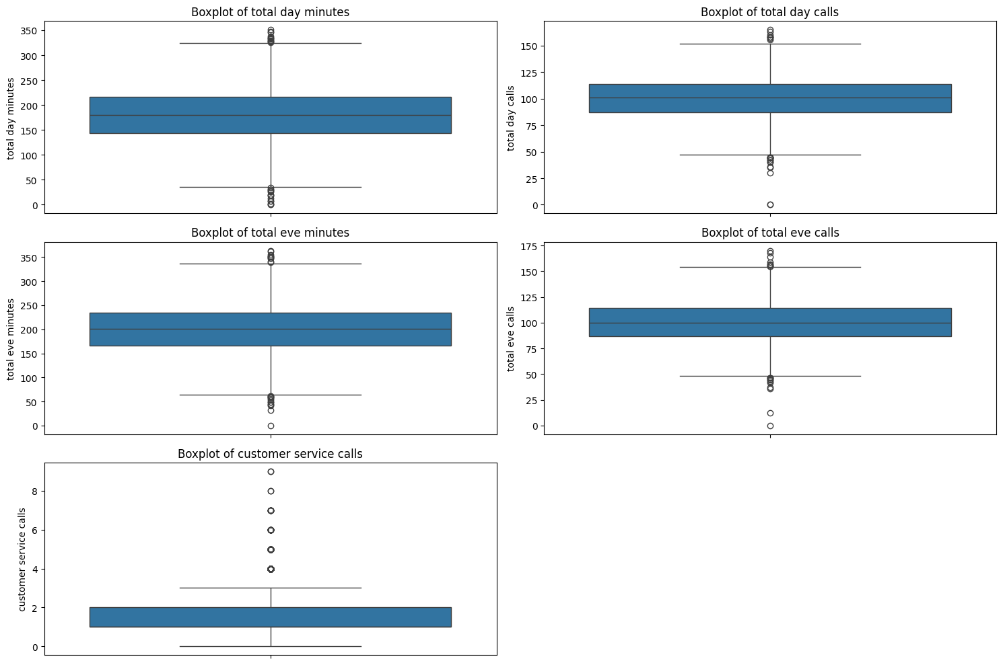
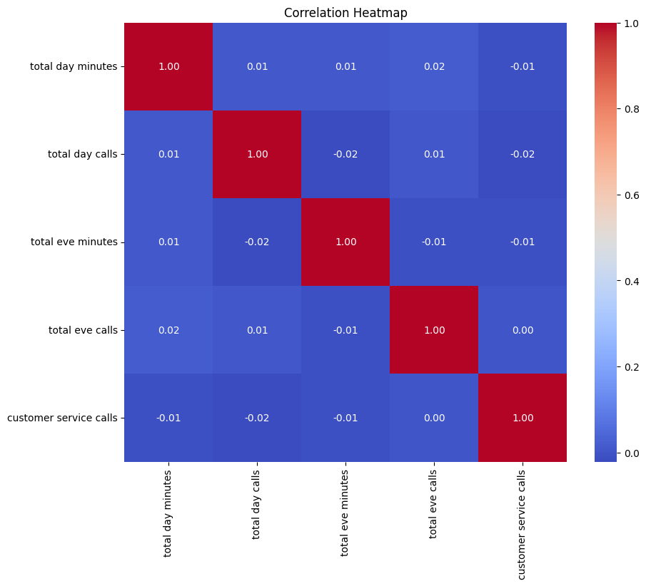
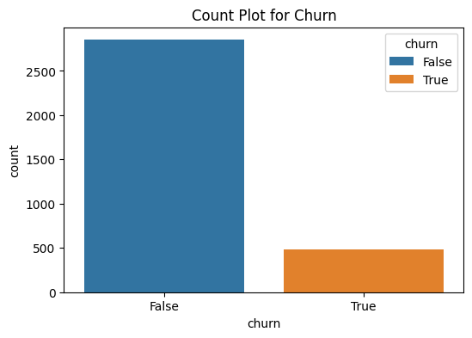

Slide 7
Model Classifiers
Random Forest Classifier was used for this exercise which scored highly.
The Model was refined using Hyper parameter Tuning.
Ensemble methods (bagging) were used to strengthen our model’s precision and predictive accuracy.
However class imbalances and our model’s accuracy not improving it needed the SMOTE technique to improve the identification of false negatives.
Finally hyperparameter tuning was done for a Random Forest classifier using GridSearchCV with cross-validation.

Slide 8
Results
Model Performance
After evaluating multiple models, the best-performing model was a Tuned Random Forest with SMOTE (Synthetic Minority Over-sampling Technique) applied to handle class imbalance. The key performance metrics of this model are as follows:
Accuracy Score: 0.902 (90.2%)
Confusion Matrix:
True Positives (Churned and correctly predicted): 92
True Negatives (Not churned and correctly predicted): 810
False Positives (Not churned but incorrectly predicted as churned): 45
False Negatives (Churned but incorrectly predicted as not churned): 53
Classification Report:
Precision for Churn Class: 0.67
Recall for Churn Class: 0.63
F1-score for Churn Class: 0.65

Slide 9
Feature Importance
The most influential features in predicting customer churn were:
Total Day Minutes 0.148060
Total Day Charge 0.142497
Customer Service Calls 0.134108
Total Eve Minutes 0.078083
Total eve minutes 0.074859
Features related to daytime usage (both minutes and charges) and customer service interactions were the most significant predictors of churn.

Slide 10
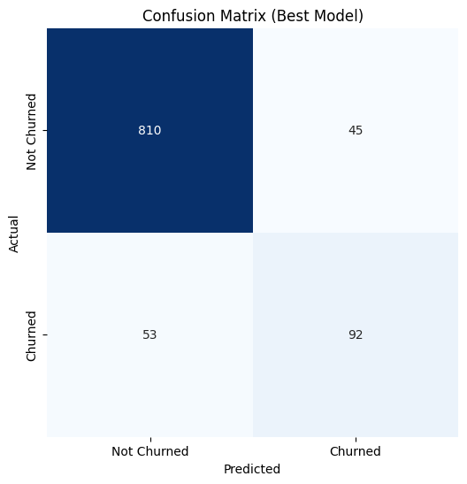
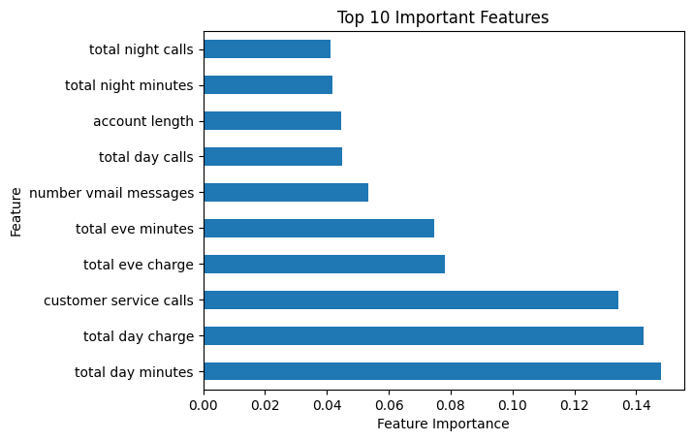

Slide 11
Conclusions
Daytime Usage Matters: Customers who spend more time and money on daytime calls are more likely to churn. Also, those who make frequent customer service calls are at higher risk of leaving.
Evening Usage Patterns: Evening call habits also impact churn prediction. High usage or charges during evening hours might indicate potential churn behavior.
International Usage: Customers with significant international calling activity or charges may have different churn probabilities.
Account Length: Longer-tenured customers show different churn behaviors compared to newer subscribers.

Slide 12
Recommendations
Know Your Customers: Split customers into groups based on their likelihood to leave and how they behave. This helps tailor efforts to keep them.
Stay Connected: Reach out to customers before they think of leaving. Send them personalized messages, offers, and solve problems quickly.
Make Services Better: Focus on improving areas like customer service, especially if they're linked to churn.
Offer Incentives: Give discounts or rewards to customers who might leave to keep them around.
Listen and Learn: Ask customers what they think and use their feedback to make things better.

Slide 13
Recommendations (Cont.)
Keep Getting Better: Keep an eye on how well the churn prediction model works and find ways to make it even more accurate.
Suggest More: Offer customers other things they might like based on what they already use.
Make Things Easy: Make sure customers have a smooth experience whenever they interact with your company.
Stay in Touch: Create special offers or messages for customers who might be thinking of leaving.
Train Your Team: Make sure everyone who talks to customers knows how to help and make them happy.

